Slide 1


Eka Pramudianzah
Data Analyst Candidate
PT Mandiri Sekuritas -
PT Indocyber Global Teknologi

Slide 2

PROFESSIONAL EXPERIENCE
PT Sinar Roda Utama, Contract (November 2024 - Present)
Data Scientist, Self-Employed Freelance (June 2021 - July 2024)
Danone Indonesia, Contract
(April – July 2024)
PT Multi Bintang Indonesia Tbk, Contract (March - December 2023)

Slide 3
Table of Contents
01
Dataset Background
02
Data Preparation
03
Data Analysis with SQL Queries
04
Conclusion
05
Data Report in Looker Data Studio

Slide 4

01
Dataset Background

Slide 5



Dataset Introduction
Three Datasets File that will be Used and Analyzed
The Format of Datasets File is CSV (Comma Separated Value)
The Name of 3 Datasets File is “cards_data.csv”, “transactions_data.csv”, and “users_data.csv”

Slide 6
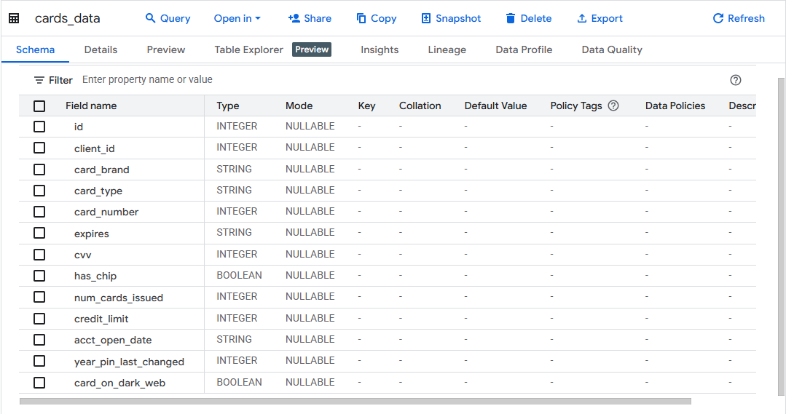
First Dataset Structure (cards_data.csv)
Total Columns “cards_data.csv” is 13 data columns

Slide 7
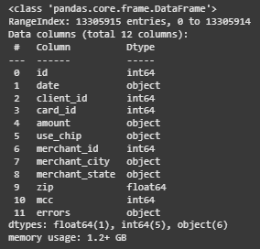
Second Dataset Structure (transactions_data.csv)
Total Columns “transactions_data.csv” is 14 data columns

Slide 8
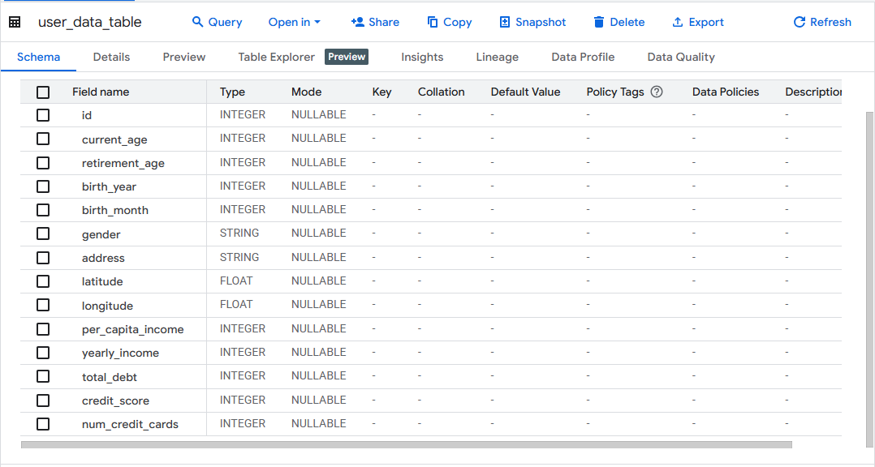
Third Dataset Structure (users_data.csv)
Total Columns “users_data.csv” is 14 data columns

Slide 9

02
Dataset Preparation

Slide 10
Preparation before Analysis in Python Notebook
01
02
03
04
Check for Missing and Duplicate Values from the 3 Dataset Files
Change the Data Type of the "date" column from String to Datetime, then Extract the Year Data and Create a New Column
Delete the "errors" and "zip" columns, then Remove Missing Values in the "merchant_state" Column from the "transactions_data.csv" Dataset File
Select only the 2019 Transaction Data, then Extract it to a New CSV Dataset File and Upload it to the Google BigQuery Console

Slide 11
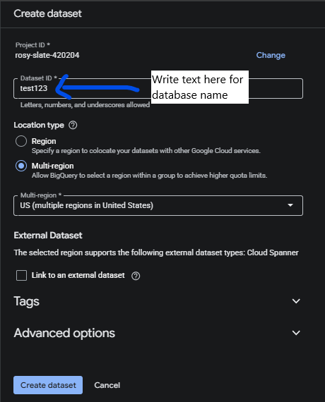
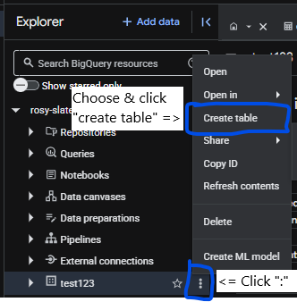
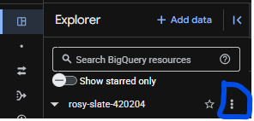
Preparation before Analysis in Google BigQuery (1)
02
03
01
Click “⋮” on the right of project name
After the database is successfully created, click “⋮” then choose "Create table" option
Write Database name and Click “Create dataset” button

Slide 12
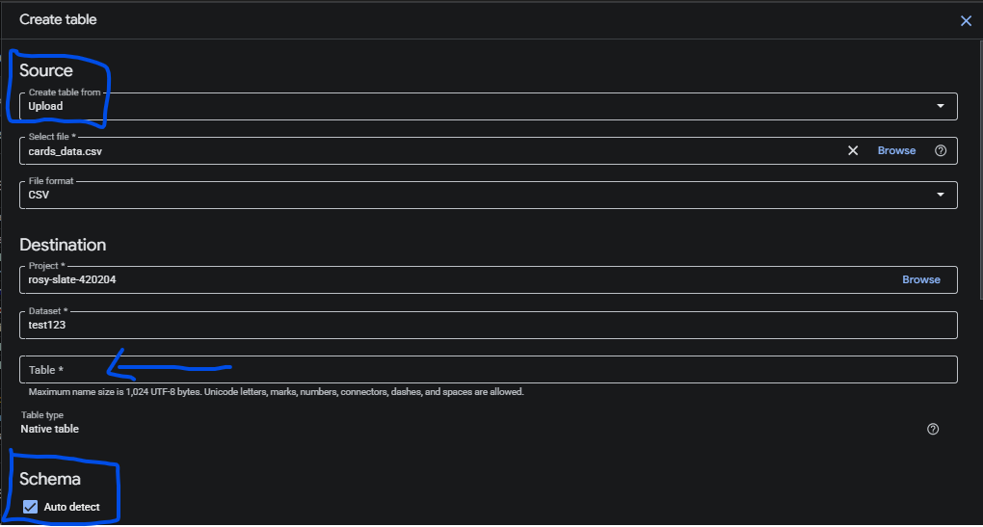
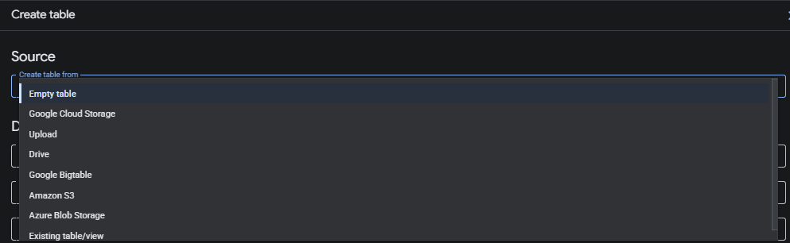
Preparation before Analysis in Google BigQuery (2)
04
Write table name here
After you choose "Create table" option, you can choose the data source that you want to use, either Google Cloud Storage, a dataset by link stored in Google Drive, or you can upload your dataset from internal storage, etc
After that, you can write table name in “Table” column then click checkbox “Auto detect” for Schema

Slide 13
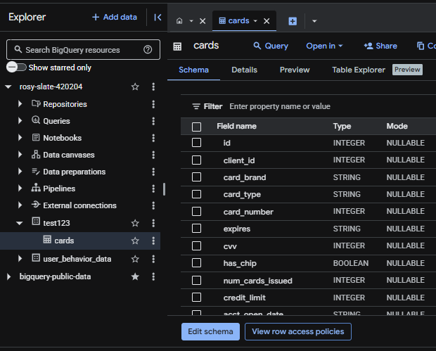
Preparation before Analysis in Google BigQuery (3)
05
The first table of the "cards_data.csv" dataset has been successfully created in the sample database named "test123"
Next, repeat the steps to upload "transactions_data.csv" and "users_data.csv"

Slide 14

03
Data Analysis with SQL Queries

Slide 15
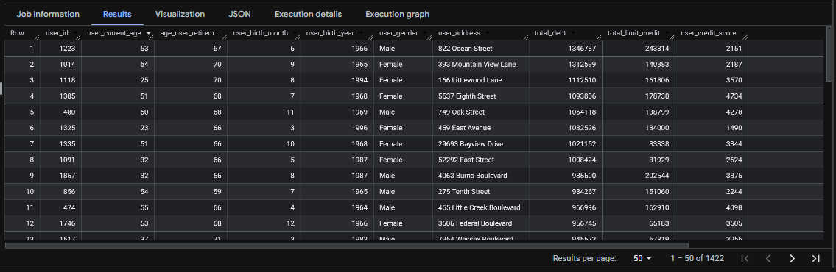
Displays User Profiles with Total Debt > Total Credit Limit, Age ≤ 60 Years, and not exceeding their respective Retirement Age

Slide 16
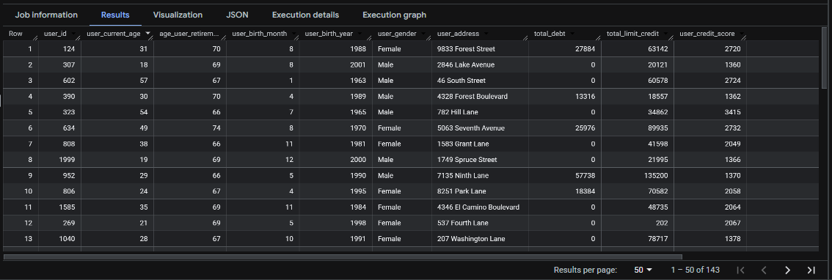
Displays User Profiles with Total Debt < Total Credit Limit, Age ≤ 60 Years, and not exceeding their respective Retirement Age

Slide 17
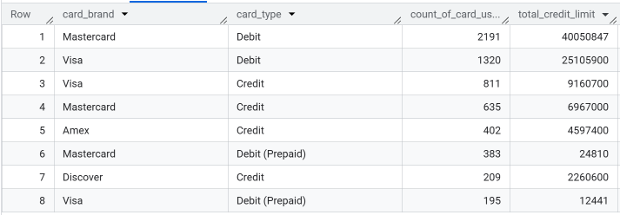
Most Frequently Used Debit & Credit Card Brand
If the purpose of using the card is Debit, then Mastercard brand is most used rather than Visa because Mastercard debit provide the highest total credit limit compared to Visa
But if the purpose of using is Credit, then Visa card brand is most used rather than Mastercard because Visa in Credit provide the highest total credit limit

Slide 18

Comparison of Total Owned Credit Card
The results above show that the most contrasting difference in user behavior is the total number of credit cards owned
More than 1.500 users (1.584 users) have more than 1 credit cards. Meanwhile, only 416 users have 1 credit card

Slide 19
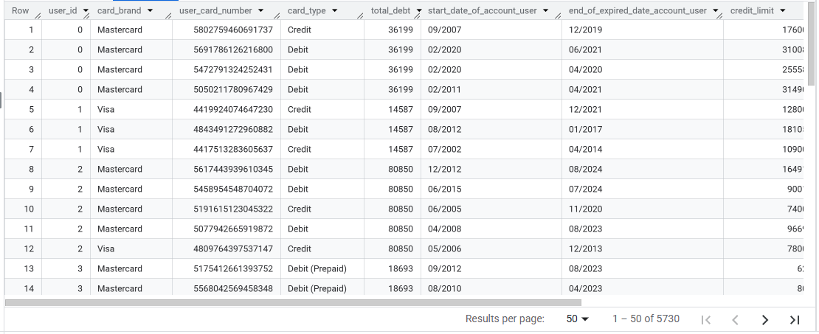
List of Users Detail who have more than 1 Credit Cards
A total of 5,730 rows of data with a distribution of 1,584 unique users have more than 1 credit card with different total credit limit

Slide 20
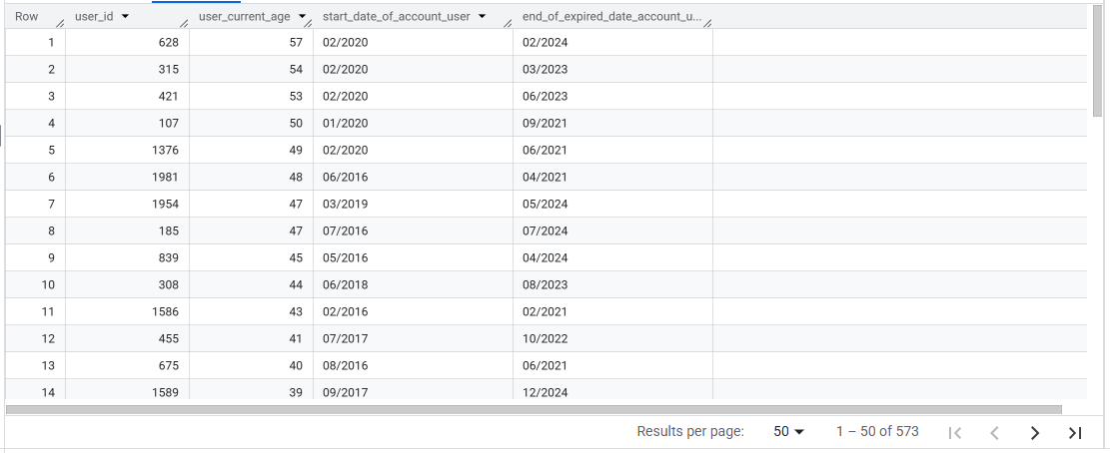

List of Users with Productive Age (23 - 60 Years) who Start Date Accounts after 2015 with Expired after 2020
A total of 436 unique users with a productive age range of 23 - 60 years produced 573 rows of data spread with the month + year of credit account creation above 2015 and the month + year of account expiration above 2020

Slide 21
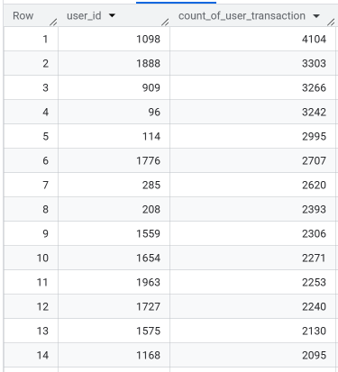
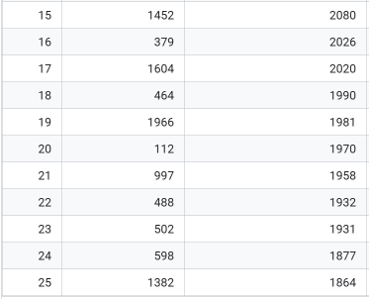
Top 25 Users with the Most Transactions in 2019
User with ID 1098 has the highest total number of transactions among the 24 other users who had the highest total transaction in 2019, 4,104 transactions
This indicates that user ID 1098 has spending behaviors, such as purchasing products/goods

Slide 22
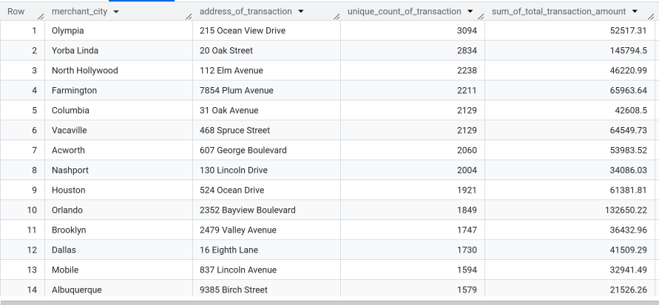
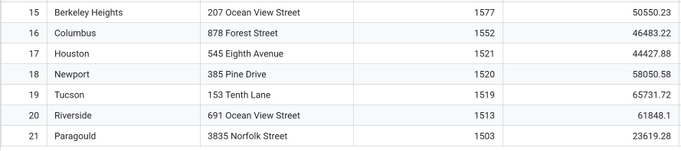
Top 21 Merchant Cities with Total Transaction > 1,500 during 2019
Olympia as one of the merchant cities had the highest number of transaction values among other cities. A total of 3.094 number transactions were conducted in Olympia first top merchant cities if we looking up from number of transaction
Furthermore, Olympia wasn’t among the merchant cities with the highest sum of total transaction amount, only 52.517 transactions
Instead, Yorba Linda, despite only having 2,834 transactions, managed to achieve a total transaction value of 145.794

Slide 23
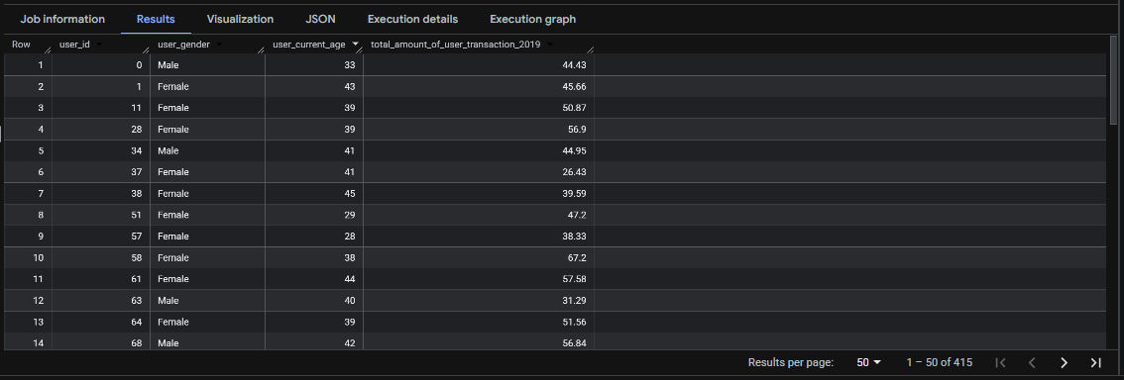
List of User Profiles with Age ≤ Average Overall Age and Total Transactions ≥ Average Total Transactions in 2019
A total of 415 users meet these two conditions, where they (the users who transact) have an age below or equal to the average age of all users and these 415 users have a total transaction value greater than or equal to the total average transaction value as a whole.

Slide 24
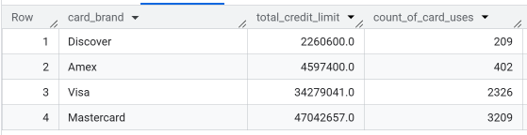
Credit Card Brand with Highest Total of Credit Limit and the Number of Uses
Mastercard credit card brand has the highest number of users with a total of 3.209
The main reason why Mastercard credit card has highest number of users because Mastercard offers and provide the highest credit limit among the other three credit card brands, Visa, Amex, and Discover, 47.042.657 total credit limit from Mastercard

Slide 25
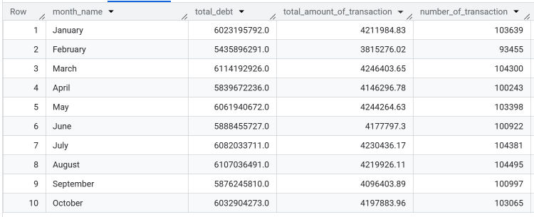
Total Debt, Total Amount of Transaction Value, and Count Distinct of Transaction per Each Month in 2019
March 2019 has the highest total debt among other months with total number of debt is 6.114.192.926.0
Still on March 2019 has the highest total amount of transaction value with number of 4.246.403.65
August 2019 has the highest of number transaction with total number is 104.495

Slide 26
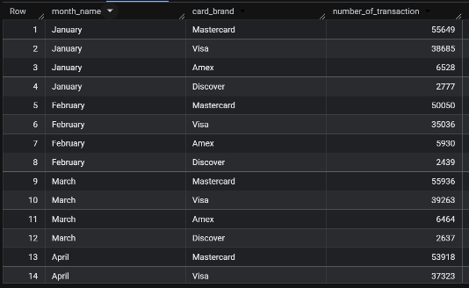
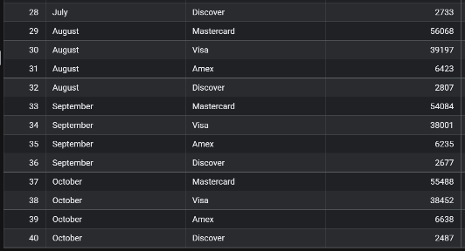
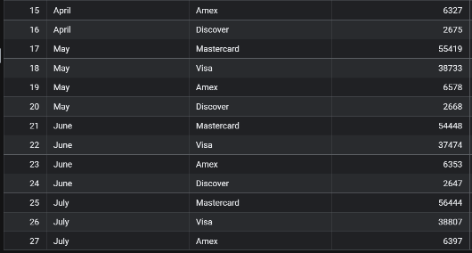
Total Number of Transactions from Each Credit Card Brand by Months
In 10 months of transactions in 2019 (January - October), Mastercard credit card brand always dominated the market because users had used almost more than 50.000 different transactions in each month

Slide 27
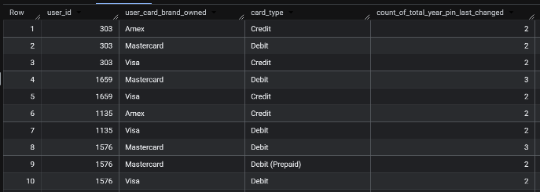
Total Number of Debit/Credit Account PIN Code Changes for Users with Ownership of > 1 Credit Card
This analysis is particularly useful for observing the behavior of users with more than one credit card, including how many times they have changed their PIN codes. For example, user ID 1659, who owns 2 different card brands (Mastercard and Visa), has changed PIN code five times, 3 changes for Mastercard and 2 changes for Visa

Slide 28
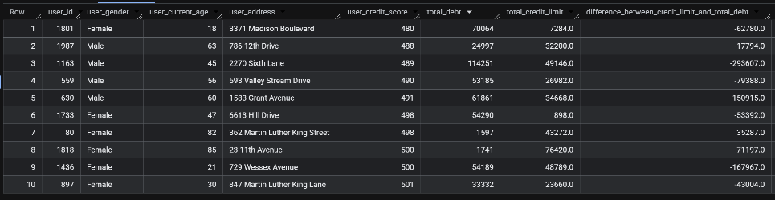
10 User Profiles with Low Total Credit Scores
By knowing the profile of the 10 users who have the lowest credit score, we can anticipate by reject all forms of credit if 10 users want to apply for additional credit when their annual income doesn’t increase/decrease. This explains that the user does not have good payment capabilities

Slide 29
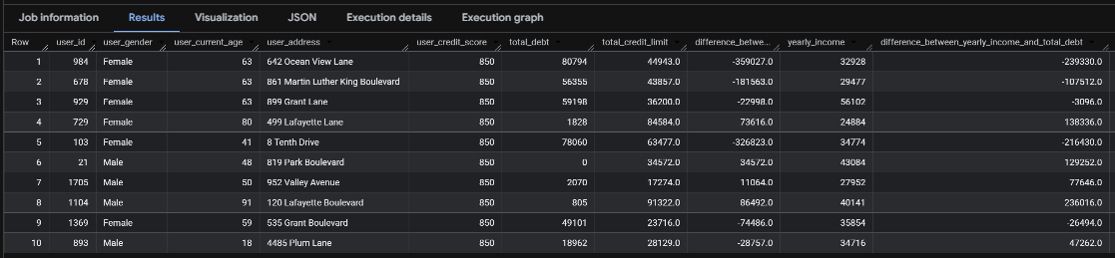
10 User Profiles with Good Total Credit Scores
By identifying the profiles of 10 users with good credit score, we can consider applying for a loan. Although, based on the difference between annual income and total debt, some users have a negative value, if they have a good credit score, we can consider them because they have a good repayment history

Slide 30

04
Conclusion

Slide 31
Final Conclusion based on Analysis using SQL Queries (1)
Olympia as a merchant city has the highest number of transactions (3.094 number of transactions) but in terms of the sum of the total amount of transactions, Yorba Linda is the merchant city with transaction of 145.794
The majority of users have more than 1 credit cards with a ratio of 416 users only have 1 credit card and 1.584 users have more than 1 credit cards
01
02
Mastercard is the most widely used credit card (3.209 users) because it provides the largest credit limits among the other 3 credit cards (47,042,657 total credit limit)
March 2019 was the month that produced the highest total debt amount and had the highest sum of total transaction amount among other months
03
04

Slide 32
Final Conclusion based on Analysis using SQL Queries (2)
05
The users credit score is very important and must be taken into account by the financial & banking industry in providing loans to users because it is the main factor in whether the user is worthy and able to repay the loan or not

Slide 33

05
Data Report in Looker Data Studio

Slide 34
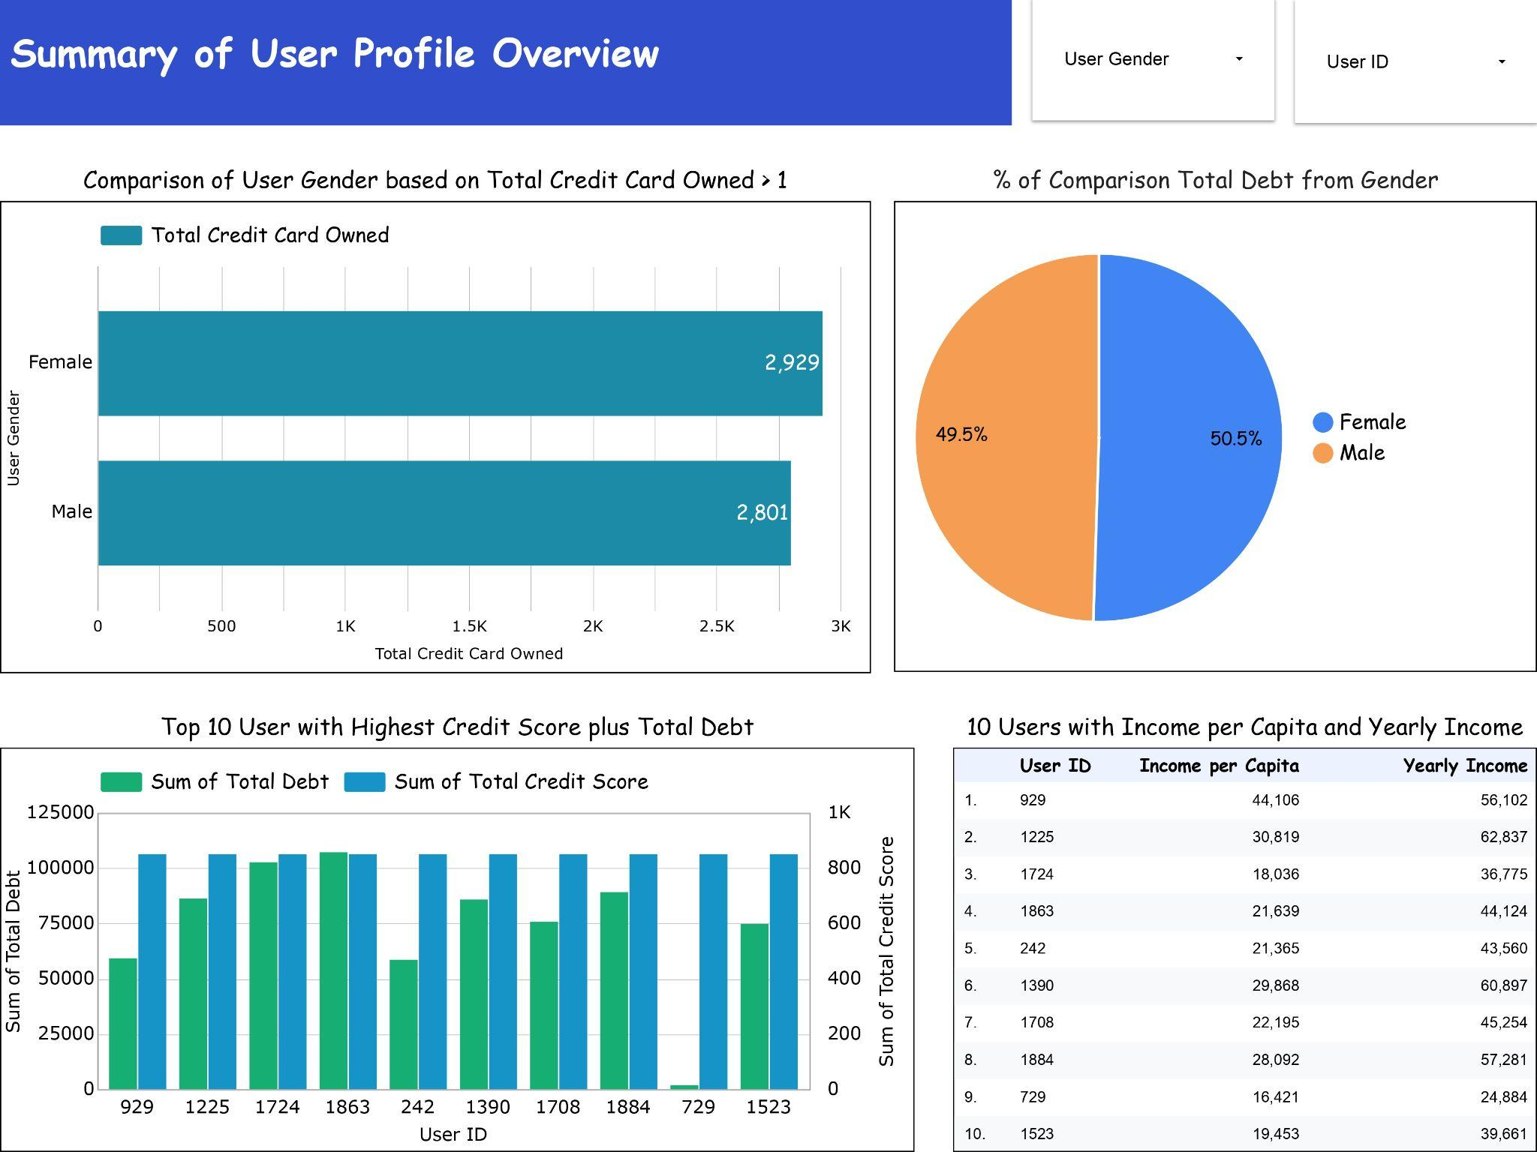
First Page in Dashboard Design

Slide 35
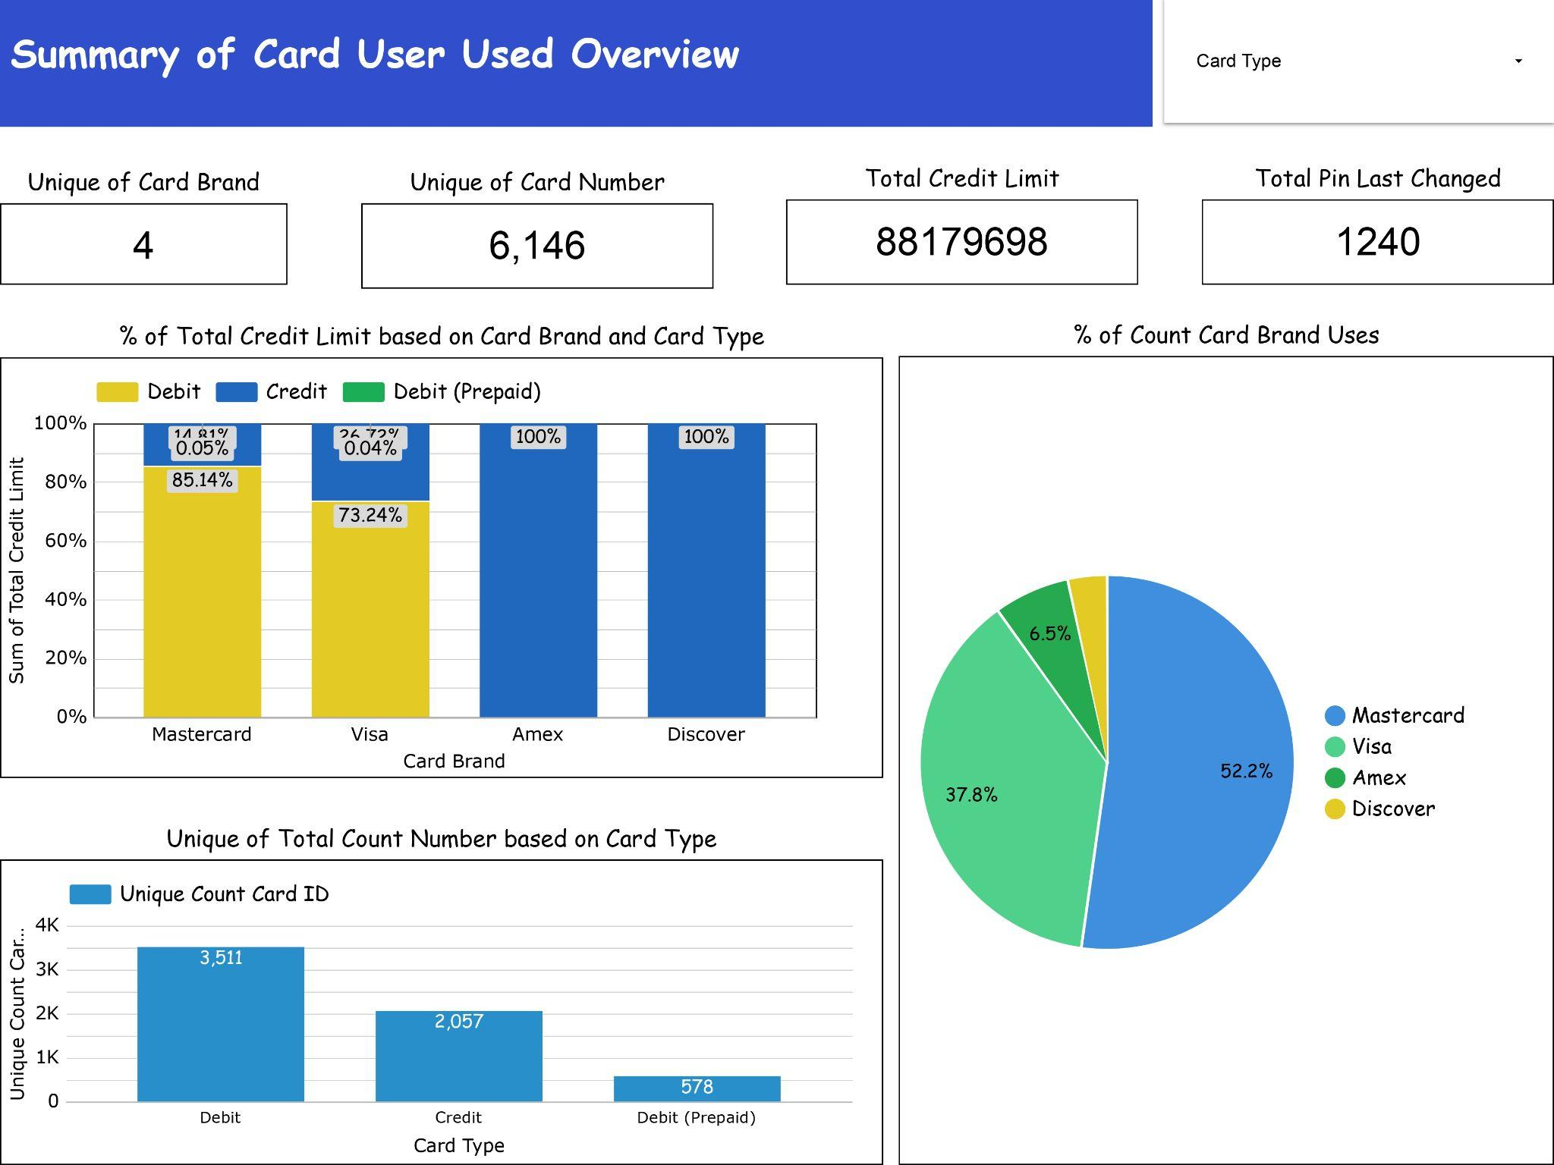
Second Page in Dashboard Design

Slide 36
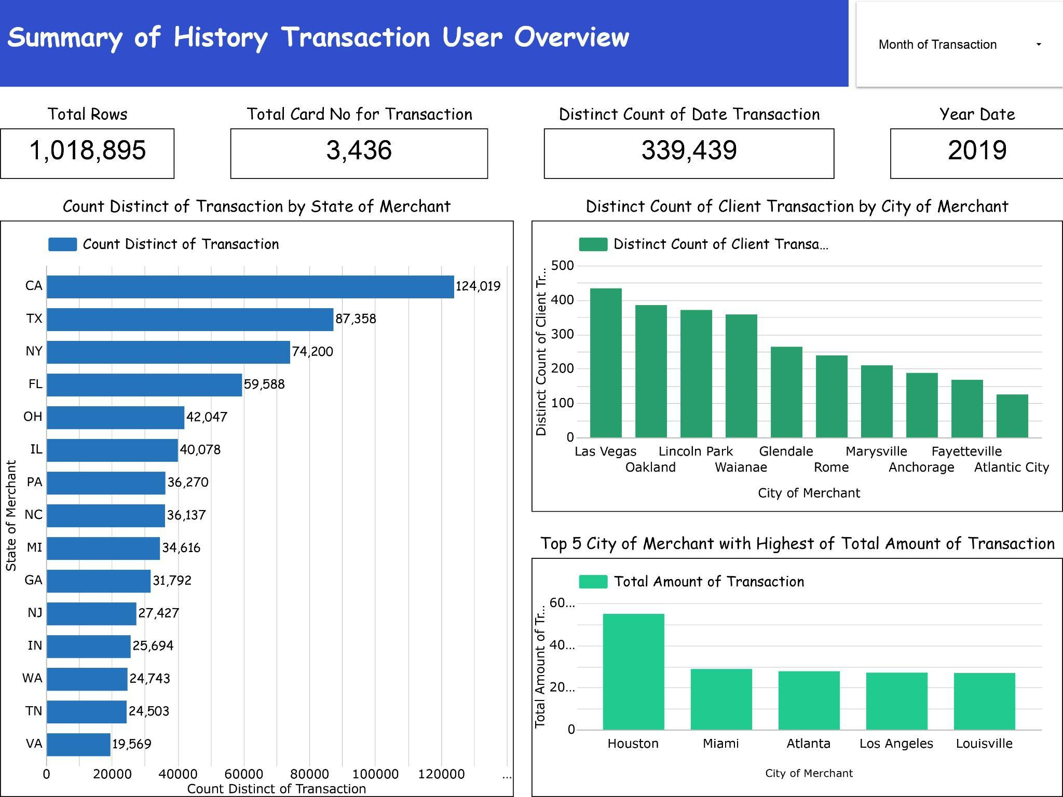
Third Page in Dashboard Design

Slide 37


THANK YOU!
Any Question?
Let’s discuss

